Slide 1
Using Data Analytics to Predict Mental Health Impacts During Pandemics
By Sudheer_kumar_suda

Slide 2
Project Overview
The project focuses on analyzing mental health impacts during COVID-19.
It aims to understand patterns of anxiety and depression, develop predictive models, and support mental resilience during future crises.

Slide 3
Motivation
COVID-19 created unprecedented mental health challenges.
There’s a need to identify root causes and develop tools for mitigating future mental health crises.

Slide 4
Objectives
Analyze mental health patterns during COVID-19.
Identify key demographic and environmental factors affecting mental health.
Predict future trends to assist in planning interventions.
Inform policy decisions with data-driven insights.

Slide 5
METHODOLOGY
Data Source: HealthData.gov, U.S. Census Bureau
Tools Used
Data Cleaning & Preparation: Python, Excel
Modelling: R Studio, Python (Machine Learning, Time Series)
Key Variables: Anxiety, Depression, Demographics, Region, Time

Slide 6
Data Collection
Source: Household Pulse Survey from HealthData.gov.
Timeframe: 2020-2024.
Dataset Size: 16,561 rows and 14 variables.
Key Variables:
Indicators (Anxiety/Depression).
Demographics (Age, Gender, Race, State).
Temporal data (Time Period, Phase).

Slide 7
Data Preparation
Cleaning Steps:
Removed unnecessary columns (e.g., Confidence Intervals).
Handled missing values by dropping rows with null entries.
Feature Engineering:
Created new columns: Age, Gender, Region, Year, and Season.
Introduced binary indicators for anxiety and depression.

Slide 8
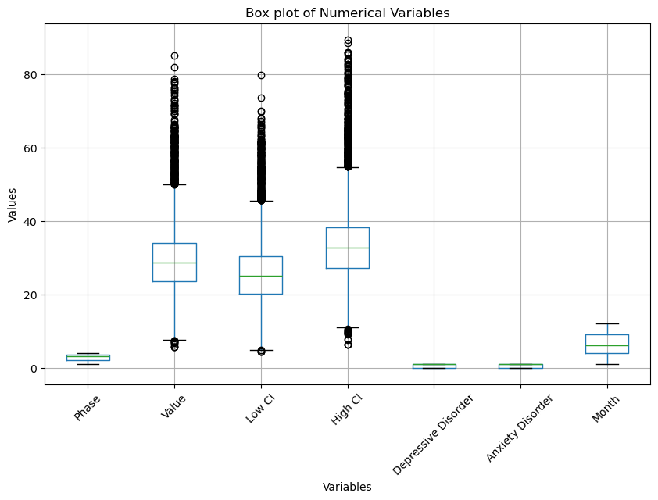
Outlier Detection
Outliers are data points significantly different from the rest, potentially impacting analysis and modeling.
Box plots and statistical methods can identify outliers, which are common in numerical and date variables.
Careful consideration is needed before removing outliers, as they might contain valuable information.

Slide 9
Analysis Techniques
Research Questions & Models:
1. Strongest Factors for Anxiety/Depression: Random Forest, Decision Tree
2. Season & Region Analysis: Random Forest, Decision Tree
3. Future Trends Forecasting: LSTM Neural Networks

Slide 10
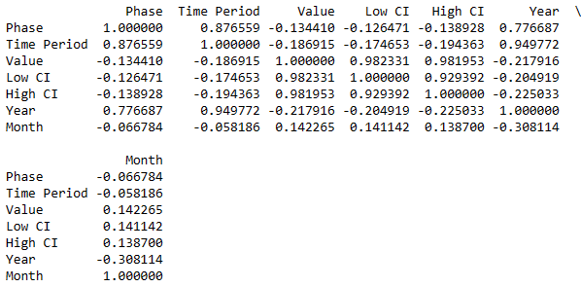
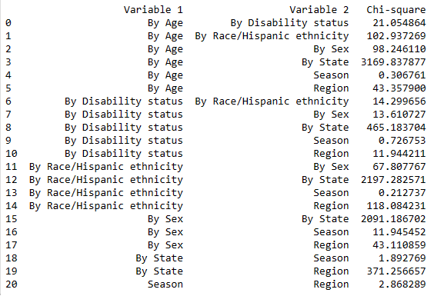
Exploratory Data Analysis
Exploratory Data Analysis (EDA) helps to understand and examine dataset characteristics.
Correlation analysis reveals relationships between variables, including numerical (Pearson correlation) and categorical (Chi-Square test).
Strong correlations were found between certain variables, such as 'Phase' and 'Time Period', and 'By Age' and 'By State'.
Correlation plot between numerical variables
Correlation between categorical variables using Chi-Square test

Slide 11
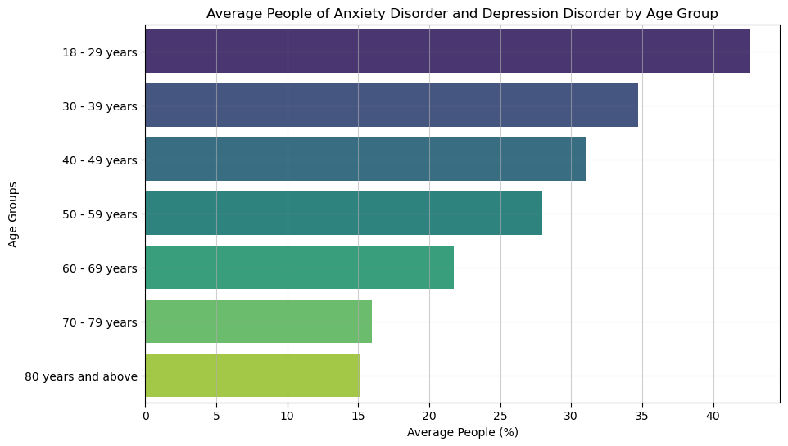
Data Visualization
In which age range are anxiety and depression disorders most common?
Bar chart analysis reveals that the 18-29 age group is most susceptible to anxiety and depression disorders in the US.
Younger individuals, especially those aged 18-29, are more likely to experience mental health issues.

Slide 12
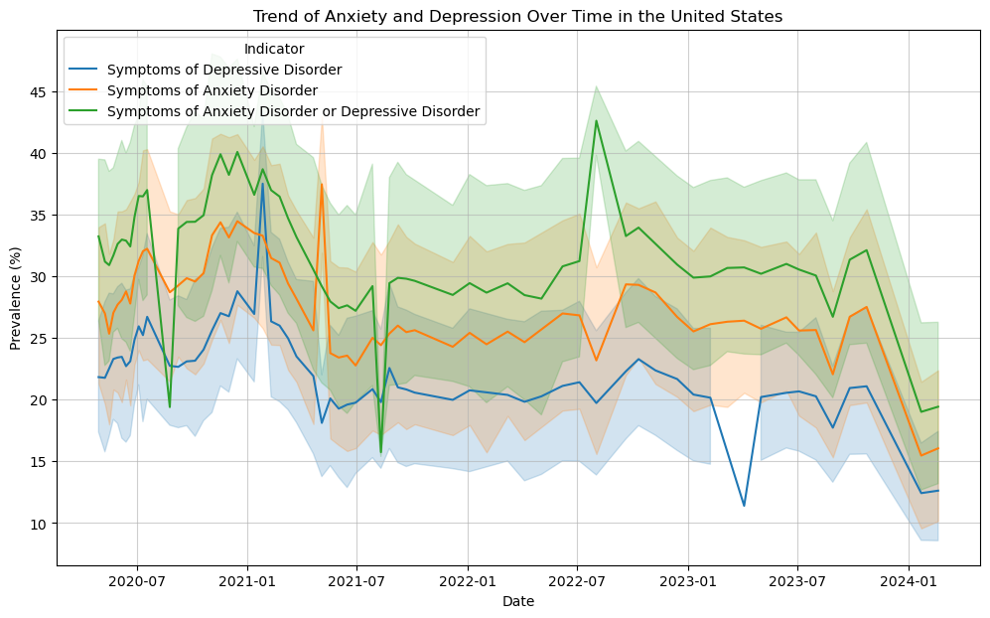
How does the pandemic’s pattern of anxiety and depression disorders evolve over time?
Line chart analysis shows a significant increase in anxiety and depression disorders during the pandemic peak.
Both disorders have declined since the peak, with anxiety disorder symptoms being more prevalent.

Slide 13
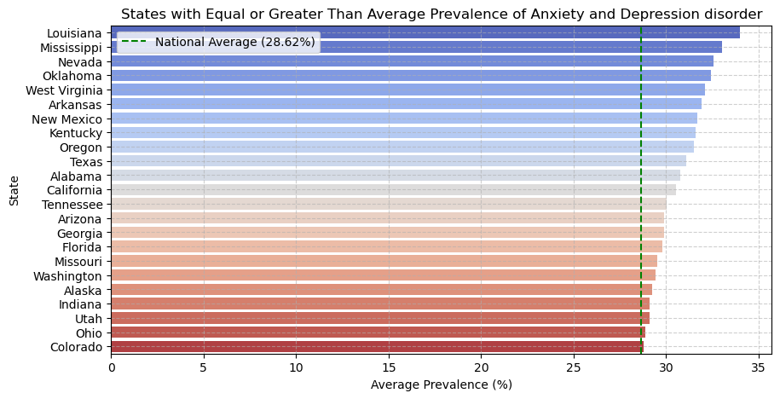
Do any states or areas have greater than average prevalence of these disorders?
23 US states have anxiety and depression disorder prevalence equal to or greater than the national average of 28.62%.
Louisiana, Mississippi, and Nevada have the highest prevalence rates.

Slide 14
Analysis Techniques
Data preparation and exploratory analysis helped us understand dataset characteristics and identify patterns through visualizations.
Machine Learning models were chosen based on research goals, as each model has unique strengths and applications.
For our study:
Predicting the strongest factors among age, disability, gender, and race for developing anxiety and depressive disorders during different stages of the COVID-19 pandemic?
Analysis Techniques: Random Forest, Decision Tree.
Predicting the likelihood of anxiety and depressive disorder based on the factors such as season and region.
Analysis Techniques: Random Forest, Decision Tree
Predicting the future trends of anxiety and depression disorder among people who are over the age of 50 years in the United States using time-series forecasting model.
Analysis Techniques: LSTM technique.

Slide 15
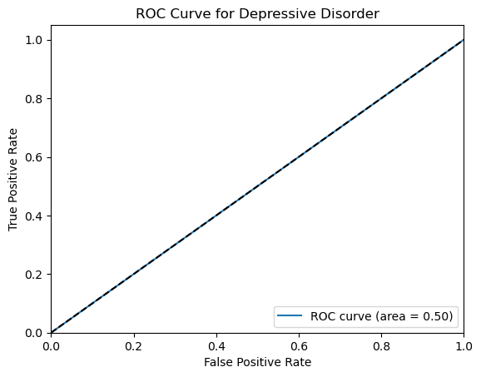
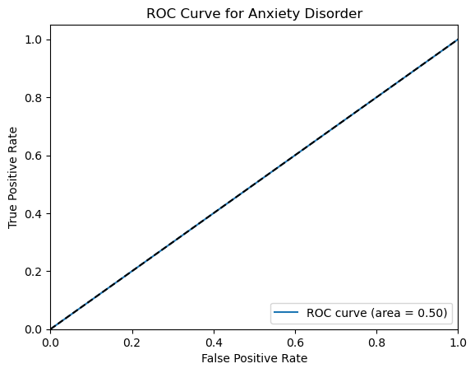
Predicting the strongest factors among age, disability, gender, and race for developing anxiety and depressive disorders during different stages of the COVID-19 pandemic?
Random Forest
Performance Metrics:
Individual accuracies: 67.69% (Depressive Disorder), 66.10% (Anxiety Disorder).
Combined accuracy: 33.79%, lower due to multi-classification complexity.High F1 scores: 0.81 (Depressive Disorder), 0.80 (Anxiety Disorder).
Key Insights:
ROC and AUC scores (0.50) show moderate performance, possibly due to similar data distributions.
Feature importance analysis highlights Gender as the most influential factor with a score of 0.35.
ROC curve of Depressive Disorder
ROC curve of Anxiety Disorder

Slide 16
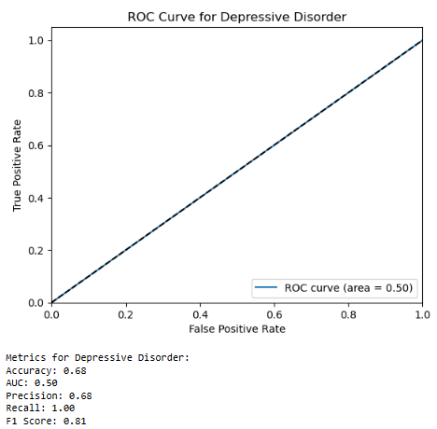
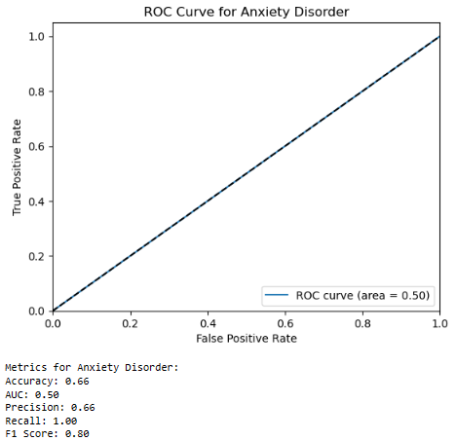
Decision Tree Model Analysis
Performance Metrics:
Accuracies: 68% (Depressive Disorder), 66% (Anxiety Disorder).
High F1 scores: 0.81 (Depressive Disorder), 0.80 (Anxiety Disorder).
ROC and AUC scores (0.50) indicate moderate model performance.
Key Insights:
Feature importance analysis shows Gender as the strongest predictor, with a score of 0.37.
Decision tree splits start with "Gender," followed by "Race/Ethnicity," "Age," and "Disability Status.
Conclusion:
Gender is the most influential factor in predicting anxiety and depressive disorders, possibly due to differences in immunity between genders during and post-pandemic.
ROC curve for depressive disorder based on Decision Tree
ROC curve for Anxiety disorder based on Decision Tree

Slide 17
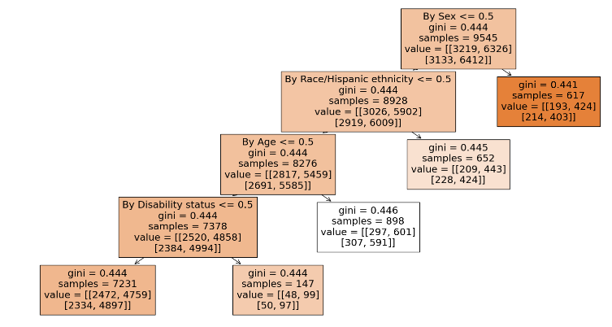
Decision Tree

Slide 18
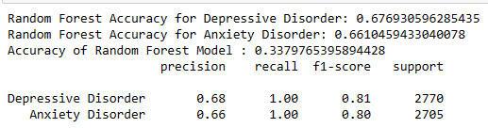
Predicting the likelihood of anxiety and depressive disorder based on the factors such as season and region.
Random Forest Model
The Random Forest model was chosen for its ability to handle classification tasks, as our target variables (Anxiety Disorder and Depressive Disorder) are binary (0/1). The dataset was split into 70% training and 30% testing data.
Accuracy: Depressive Disorder: 67.69%, Anxiety Disorder: 66.10%, Combined: 33.79%.
Lower combined accuracy is expected due to multi-classification complexity but does not indicate poor performance.
Evaluation Metrics of Random Forest Model
ROC curve of Depressive Disorder

Slide 19
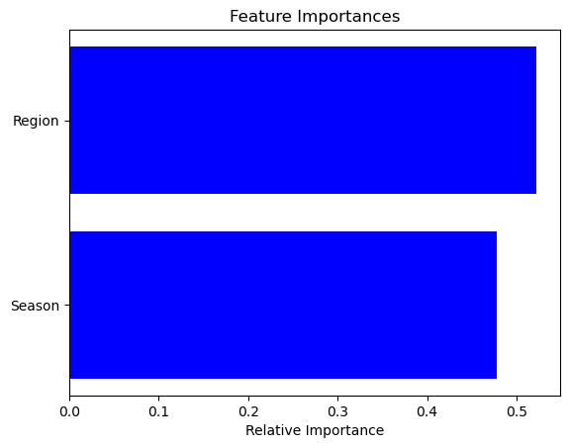
Evaluation Metrics:
Depressive Disorder: Precision: 0.68, Recall: 1.00, F1-Score: 0.81
Anxiety Disorder: Precision: 0.66, Recall: 1.00, F1-Score: 0.80
AUC & ROC: AUC scores of 0.50 for both disorders indicate moderate performance.
Key Insights: Feature importance analysis shows that the region significantly influences the likelihood of anxiety and depressive disorders, emphasizing its role in prediction.
ROC curve of Anxiety Disorder
Importance Score of variables

Slide 20
Decision Tree Model
The Decision Tree model was chosen for its simplicity and ability to provide interpretable insights through tree-like structures. The dataset was split into 70% training and 30% testing data.
Accuracy: Depressive Disorder: 68%, Anxiety Disorder: 66%
Evaluation Metrics:
Depressive Disorder: Precision: 0.68, Recall: 1.00, F1-Score: 0.81
Anxiety Disorder: Precision: 0.66, Recall: 1.00, F1-Score: 0.80
AUC & ROC: AUC scores of 0.50 for both disorders indicate moderate performance
ROC curve for depressive disorder based on Decision Tree

Slide 21
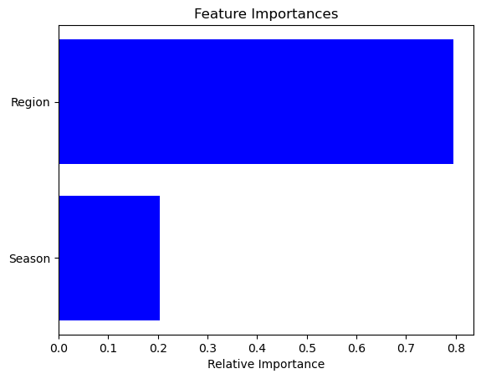
Key Insights:
Region is the most significant factor influencing anxiety and depressive disorders, with a high importance score of 0.8.
Visualized tree splits show "Season" as the first factor, followed by features like race/ethnicity, age, and disability status.
Regional differences in eating habits, lifestyle, and weather likely contribute to variations in disorder likelihood.
Overall, the region is a stronger predictor than the season for thes
ROC curve for Anxiety disorder based on Decision Tree
Importance score of variables

Slide 22
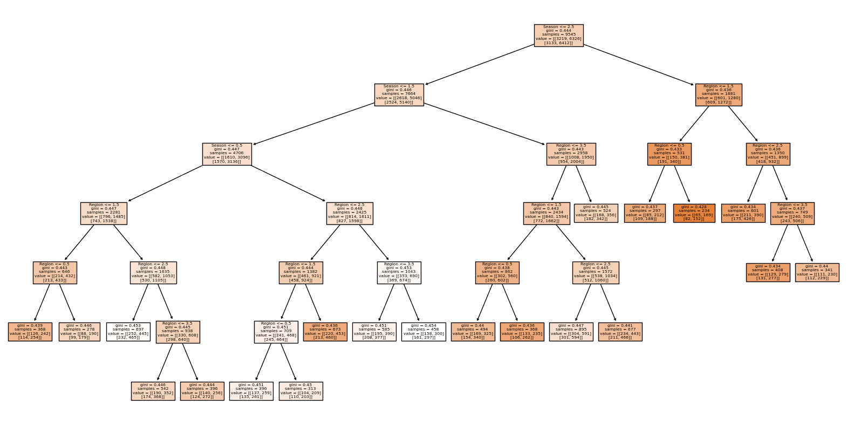
Decision Tree

Slide 23
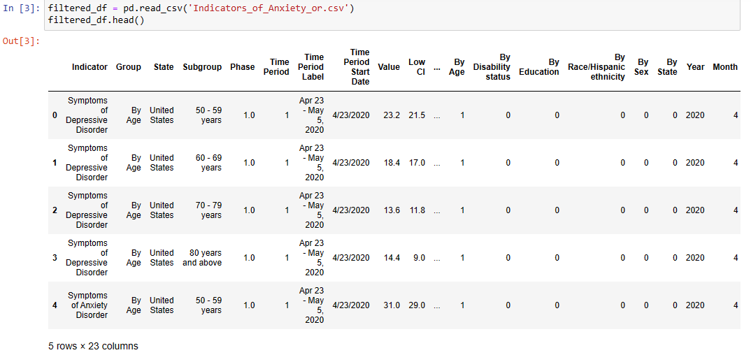

Predicting the future trends of anxiety and depression disorder among people who are over the age of 50 years in the United States using time-series forecasting model.
LSTM Neural Network Model :
We used the LSTM model to predict future trends of anxiety and depressive disorders in people aged 50 and above.
Data Preparation:
Filtered the dataset for age groups ≥ 50 years.
Normalized the target variable (‘Value’) using MinMax Scaler.
Set the input sequence to 12 (12 data points to predict the next point) and number of features to 1.
Split the data into 70% training and 30% testing.
Example dataset after filtering Subgroup to age >= 50
Python Code to build LSTM model.

Slide 24
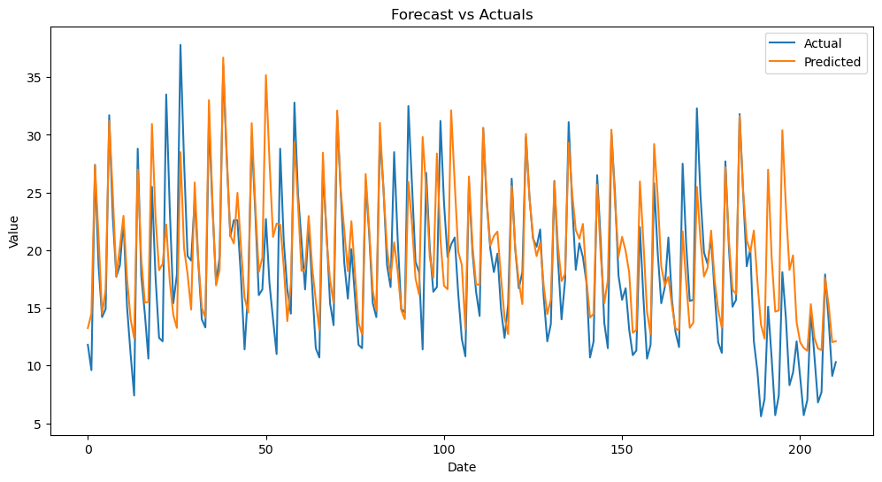
Model Structure:
Built using 2 LSTM layers (100 and 50 neurons) and 1 dense layer.
Trained for 20 epochs.
Results:
The predicted and actual values align closely, indicating good model performance.
Forecast for the next 15 days shows a gradual increase in disorder indicators, with the highest predicted value of 16.5 on 2024/02/15.
Key Insight: The LSTM model effectively forecasted future trends of anxiety and depression disorders in the target age group.
Forecast vs Actuals Values Comparison

Slide 25
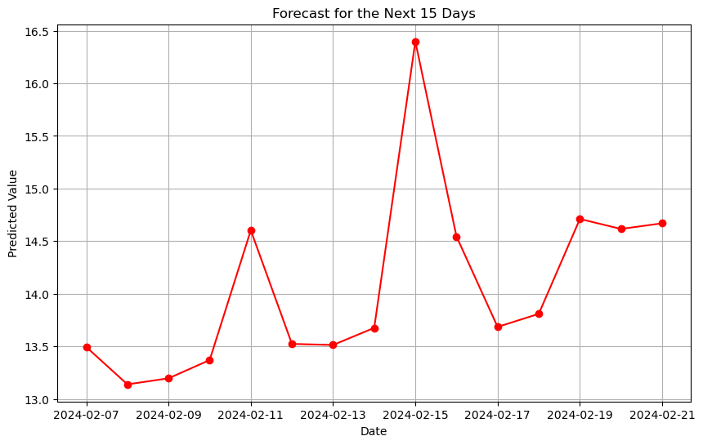
Value for Future 15 days value of the indicators

Slide 26
Results
Exploratory Data Analysis (EDA)
Visual Insights: Line charts effectively show trends, seasonality, and patterns, while bar charts excel at comparisons across groups.
Key Findings:
Younger age groups (18-29) have higher chances of anxiety and depression, with prevalence decreasing as age increases.
From 2020-2024, anxiety and depressive disorder symptoms peaked in 2022 due to COVID-19, with a decline in recent years.
Disorder prevalence by state shows Louisiana as the highest and Colorado as the lowest, with clear visualization through heatmap-based bar charts.
Predictive Analysis:
Question 1: Random Forest and Decision Tree models achieved 68% accuracy, highlighting the influence of factors like age, gender, disability, and race on disorders.
Question 2: Both models worked well for categorical and numerical data, with Random Forest performing slightly better in accuracy, while Decision Tree offered more patterns and insights.
Question 3: Future trends of disorders in age groups ≥50 were accurately forecasted using LSTM, revealing an upward trend with precise pattern identification.
Conclusion:
The combination of visualizations, models, and algorithms provided actionable insights into anxiety and depression trends, offering valuable perspectives for real-world scenarios.

Slide 27
Thank you

